Slide 1
British Airways Virtual Internship – Task 1 _______________________
This is the sentiment Analysis of the customer Reviews for British Airways available on the website Skytrax.
1. Python has been used here to scrap the data from the site.
2. The Dataset formed was cleaned and preprocessed.
3. Then VADER library was used to perform sentiment Analysis.
4. The results were visualized using Matplotlib PIE chart and Wordcloud

Slide 2
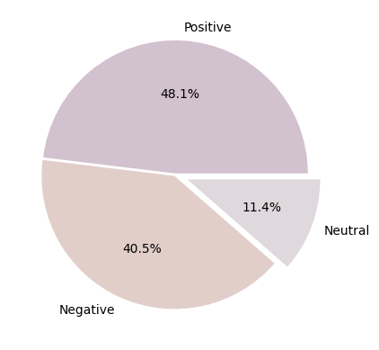
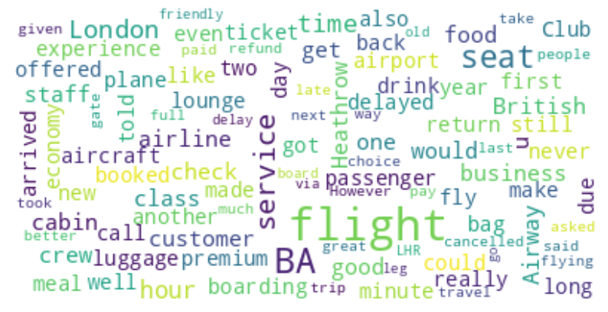
Visualized Results
PIE CHART WORD CLOUD

